Slide 1
Passive (1) in Simple present, Simple past, Simple future Tense

Slide 2
Kinds of verb
There are 3 kinds of verbs;
Verb 1>>> Present
Verb 2>>> Past
Verb 3>>> Past Participle

Slide 3
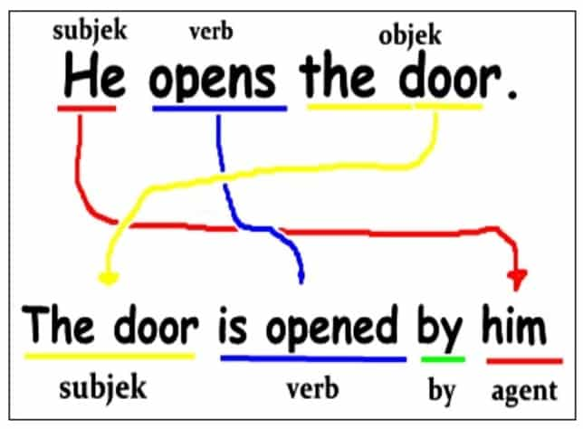

Slide 4
A passive verb has a form of be and V3, e.g. sent, written, helped, made, taken, etc.
Passive form in Simple Present : S + is/am/are + V3
Passive form in Simple Past : S + was/were + V3
Passive form in Simple Future : S + will be + V3
General form: S + be + V₃
Example:
Tense | Active | Passive
Simple Present | John helps Mary | Mary is helped by John
Simple Past | John helped Mary | Mary was helped by John
Simple Future | John will help Mary | Mary will be helped by John

Slide 5
Have to know
Subject in passive sentence is the object in the active one.
All passive sentences must use Verb 3.
After Verb 3, we can add by + Subject in passive sentence.

Slide 6
Activity 2 - Change the sentences to passive
1. Jill borrowed my pen yesterday.
____________________________
2. Ray will buy the shoes tomorrow.
____________________________
3. Eddy took the boxes.
____________________________
4. A postman delivers the letters.
____________________________
5. A new teacher will teach their class.
____________________________
6. David bought a black motorcycle.
____________________________
7. The boys play basketball.
____________________________
8. We will start English lesson soon.
____________________________
9. She reads emails every night.
____________________________
10. I often listen to mp3 songs.
___________________________

Slide 7
Activity 3 - Write active voices using the “words” below & change them to passive. Study the examples
Example: 1. Make
Simple Present - Active : My mother makes a cake every month
Passive : A cake is made by my mother every month.
Simple Past - Active : My mother made a cake yesterday.
Passive : A cake was made by my mother yesterday.
Simple Future - Active : My mother will make a cake tomorrow
Passive : A cake will be made by my mother tomorrow.
1. Drink
2. Study
3. Watch
4. Eat
5. Ride

